Slide 1

MUSIC LABEL
FINAL TERM PROJECT
Database Management and Practice - Fall 2023
Professor - Mehdi Pirahandeh

Slide 2





The Team
The Team
The Team
LUIS FELIPE DEPARDON JASSO
MEDIA COM
12235233
The Team
THIRI MOE HTET
IBT
12214682
CHAW THIRI SAN
ISE
12225272
VU NGUYEN BAO NGOC
IBT
12225193

Slide 3

MUSIC LABEL MUSIC LABEL MUSIC LABEL MUSIC LABEL MUSIC LABEL MUSIC LABEL
Without music,
life would be a mistake.
FRIEDRICH NIETZSCHE
MUSIC LABEL MUSIC LABEL MUSIC LABEL MUSIC LABEL MUSIC LABEL MUSIC LABEL
Notes:
As we all have passion for music, we want to apply what we learnt in this class to make a database can be managed effectively within a music label

Slide 4


ABOUT US
Our database system aspires to establish and effectively manage the operation of a MUSIC LABEL

Slide 5
OUR SYSTEM
CONTENT
Artist
Albums & Singles
Contracts
Artist events
Album sales
I. Introducing
tables
II. Data insertion
III. Queries by
team members
Notes:
We will mainly work with the following subjects: artist, album and singles, contracts, events and sales.
In order for you to get to know our system, our team members will walk you 3 main parts: firstly, what are the main tables, secondly, how we inserted dummy data, and thirdly, how each team member execute their SQL queries.

Slide 6
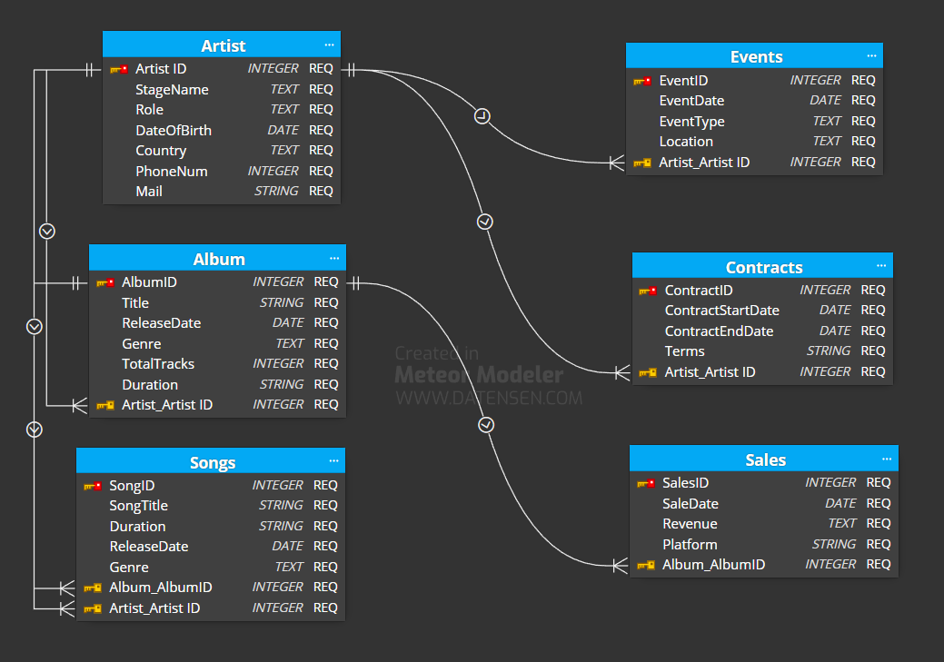
VU NGUYEN BAO NGOC - 12225193
I. INTRODUCING TABLES
ERD Diagram
6 tables in total
Notes:
Firstly, for the overall understanding of our system, I created the ERD diagram.
This ERD shows the relationships between six entities within our music database. It represents crucial components like Artists, Albums, Songs, Events, Contracts, and Sales, reflecting their associations and dependencies.
Most attributes have NOT NULL constraint as these are mostly required information.
As for Data Integrity:
Throughout the design process, I've ensured data integrity by using appropriate data types, constraints, and avoiding redundancy, fostering a more efficient and maintainable database structure.

Slide 7
LUIS FELIPE DEPARDON JASSO - 12235233
I. INTRODUCING TABLES
Deeper analysis of tables
Artist
- ArtistID (Primary Key)
- ArtistName
- StageName
- Role
- DateOfBirth
- Country
- PhoneNum
- Mail
Albums
- AlbumID (Primary Key)
- ArtistID (Foreign Key referencing Artist table)
- Title
- ReleaseDate
- Genre
- TotalTracks
- Duration
Songs
- SongID (Primary Key)
- SongTitle
- Duration
- ReleaseDate
- Genre
- AlbumID (Foreign Key referencing Album table)
- ArtistID (Foreign Key referencing Artist table)
- ProducerID (Foreign Key referencing Role table)

Slide 8
LUIS FELIPE DEPARDON JASSO - 12235233
I. INTRODUCING TABLES
Deeper analysis of tables
Events
- EventID (Primary Key)
- EventType (concert, release party, etc.)
- EventDate
- Location
- ArtistID (Foreign Key referencing Artist table)
Contracts
- ContractID (Primary Key)
- ArtistID (Foreign Key referencing Artist table)
- ContractStartDate
- ContractEndDate
- Terms (details of the contract)
Sales
- SaleID (Primary Key)
- AlbumID (Foreign Key referencing Album table)
- SaleDate
- Revenue
- Platform

Slide 9
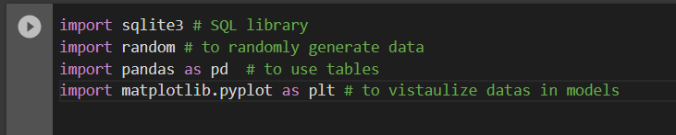
CHAW THIRI SAN - 12225272
II. Data Insertion
Artist, Albums & Songs Tables
Built in modules

Slide 10
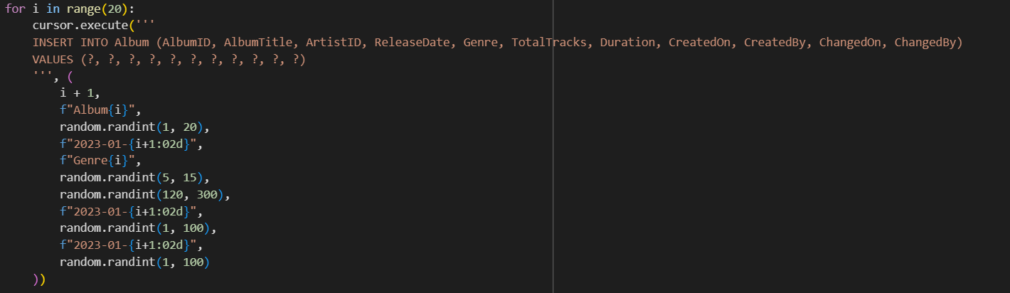
CHAW THIRI SAN - 12225272
II. Data Insertion
Artist, Albums & Songs Tables
Codes
20 lines of random datas for each table using Random module

Slide 11
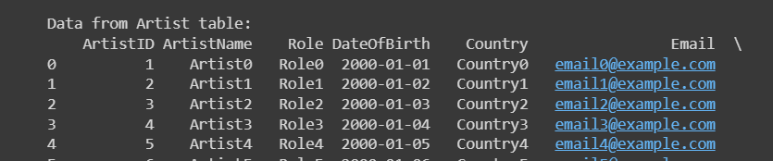
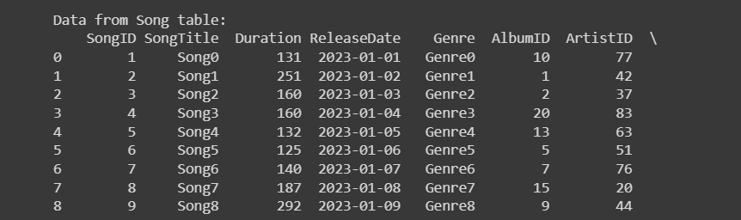
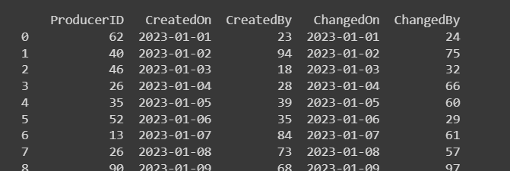
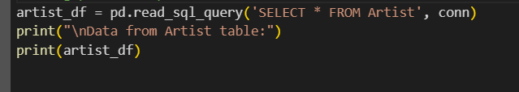
Results
Print out the results
in table format using pandas for readability

Slide 12
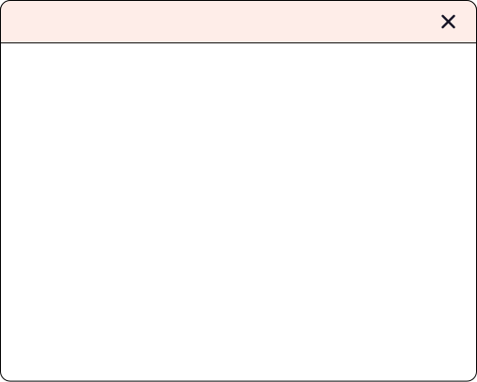
THIRI MOE HTET - 12214682
II. Data Insertion
Event, Sale, & Contract Tables
Establishing Connection
Utilizing 'sqlite3' and 'random' modules
Connects to 'Music-Label.db' SQLite database
Creates a cursor for executing SQL commands
Retrieves existing ArtistIDs from the 'Artist' table
Inserts data into the 'Event', ‘Contract’, & ‘Sale’ tables
Randomly selects ArtistID and generates random values
Commits changes to the SQLite database
Print all data from the tables
Closes the connection to the database
import sqlite3
import random
SELECT ArtistID FROM Artist
INSERT INTO Event..,INSERT INTO Contract..., INSERT INTO Sale...
conn.commit()
SELECT * FROM Event, SELECT * FROM Contract, SELECT * FROM Sale
conn.close()

Slide 13
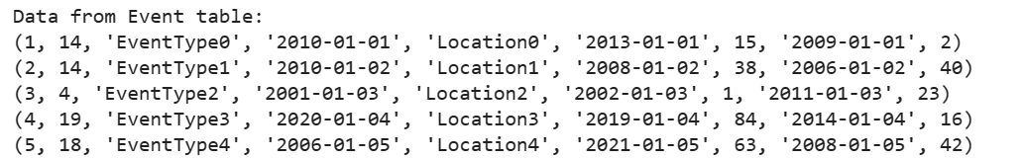
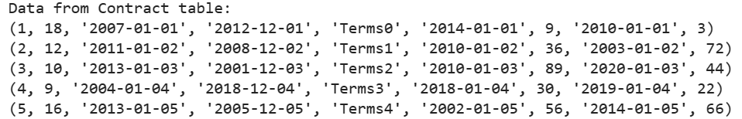
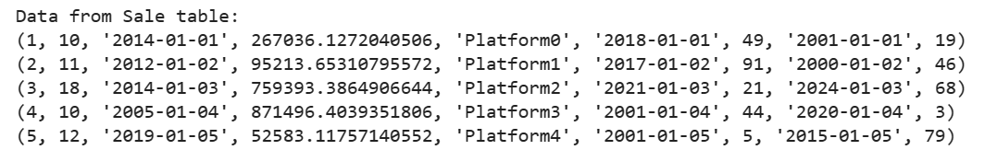
Sample Output

Slide 14

QUERIES QUERIES QUERIES Q
QUERIES QUERIES QUERIES Q
QUERIES QUERIES QUERIES Q
QUERIES QUERIES QUERIES Q
THIRI MOE HTET
12214682

Slide 15
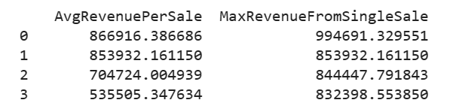
ADVANCED SQL - THIRI MOE HTET - 12214682
Ranking Total Sales for Artists
Utilizes RankedSales and TopSales CTEs for Revenue Ranking
window function ROW-FUNCTION() to give a sequential number to each row in the result
--
WITH RankedSales AS (
SELECT
SaleID,
AlbumID,
Revenue,
ROW_NUMBER() OVER (PARTITION BY AlbumID ORDER BY Revenue DESC) AS SaleRank
FROM
Sale
),
TopSales AS (
SELECT
SaleID,
AlbumID,
Revenue
FROM
RankedSales
WHERE
SaleRank = 1
)

Slide 16
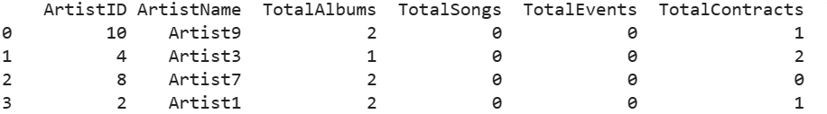
INTERMEDIATE SQL - THIRI MOE HTET - 12214682
Generating Songs, Events, Contracts, & Revenues associated with Each Artist
COUNT(DISTINCT AL.AlbumID) AS TotalAlbums,
COUNT(DISTINCT S.SongID) AS TotalSongs,
COUNT(DISTINCT E.EventID) AS TotalEvents,
COUNT(DISTINCT C.ContractID) AS TotalContracts,
AVG(SL.Revenue) AS AvgRevenuePerSale,
MAX(TS.Revenue) AS MaxRevenueFromSingleSale
Aggregates Metrics for Total Albums, Songs, Events, Contracts, and Revenue

Slide 17
ADVANCD SQL - THIRI MOE HTET - 12214682
Generating Songs, Events, Contracts, & Revenues associated with Each Artist
LEFT JOIN
Song S ON A.ArtistID = S.ArtistID
LEFT JOIN
Event E ON A.ArtistID = E.ArtistID
LEFT JOIN
Contract C ON A.ArtistID = C.ArtistID
LEFT JOIN (
-- Subquery to find the average revenue per sale
SELECT
AL.AlbumID,
AVG(SL.Revenue) AS Revenue
a series of LEFT JOIN operations involving multiple tables (Album, Song, Event, Contract) on the common column ArtistID.
Subqueries for Average Revenue Calculation

Slide 18
INTERMEDIATE SQL - THIRI MOE HTET - 12214682
Generating Songs, Events, Contracts, & Revenues associated with Each Artist
Filtering Artists with at Least One Album (HAVING Clause)
GROUP BY clause will group rows of result set based on unique combinations of ‘ArtistID’ and “ArtistName’,
HAVING
TotalAlbums > 0
GROUP BY
A.ArtistID, A.ArtistName

Slide 19
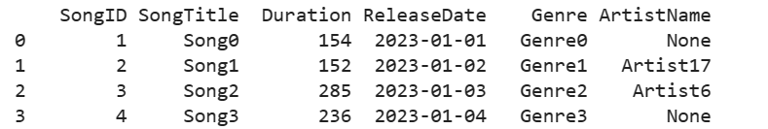
INTERMEDIATE & ADVANCED SQL - THIRI MOE HTET - 12214682
Creating Base Query to Filter Songs
Utilizes LEFT JOIN with the Song and Artist tables.
the database use indexes on columns like SongID, ArtistID, and Genre to speed up the query execution process.
def get_filtered_songs(artist_name=None, genre=None, min_duration=None):
sql_query = '''
SELECT
S.SongID,
S.SongTitle,
S.Duration,
S.ReleaseDate,
S.Genre,
A.ArtistName
FROM
Song S
LEFT JOIN
Artist A ON S.ArtistID = A.ArtistID
WHERE
1 = 1
get_filtered_songs()

Slide 20
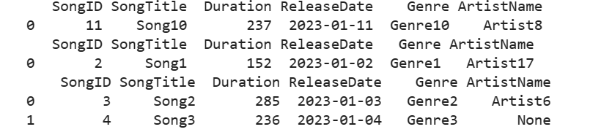
INTERMEDIATE & ADVANCED SQL - THIRI MOE HTET - 12214682
Adding Conditions to Filter Songs
Dynamic SQL refers to the creation of SQL statements at runtime, allowing the construction of queries based on certain conditions or variables.
In this case, the conditions are added to the sql_query string based on whether certain parameters (artist_id, genre, min_duration) are provided.
Uses if-then-else types logic as in Case statements
# Add dynamic conditions based on user inputs using CASE statements
if artist_name:
sql_query += f" AND A.ArtistName = '{artist_name}'"
if genre:
sql_query += f" AND S.Genre = '{genre}'"
if min_duration:
sql_query += f" AND S.Duration >= {min_duration}"
# Retrieve songs by a specific artist
get_filtered_songs(artist_name='Artist8')
# Retrieve songs of a specific genre
get_filtered_songs(genre='Genre1')
# Retrieve songs with a minimum duration of 200 seconds
get_filtered_songs(min_duration=200)

Slide 21
QUERIES QUERIES QUERIES Q
QUERIES QUERIES QUERIES Q
QUERIES QUERIES QUERIES Q
QUERIES QUERIES QUERIES Q
LUIS FELIPE DEPARDON JASSO
12235233

Slide 22
INTERMEDIATE SQL - LUIS FELIPE DEPARDON JASSO - 12235233
1) Classifying songs by duration
SELECT SongTitle,
CASE
WHEN Duration < 120 THEN 'Short'
WHEN Duration >= 120 AND Duration <= 180 THEN 'Medium'
ELSE 'Long'
END AS DurationCategory
FROM Song;
Case clause.
Music statistics.
Select SongTitle Column.
Add case statement for each clasification.
Select the table.
Case helps when there are multiple conditions.
Result example: ('Song0', 'Long')

Slide 23
INTERMEDIATE SQL - LUIS FELIPE DEPARDON JASSO - 12235233
2) Total songs and average duration for each genre
SELECT Genre, COUNT(SongID) AS TotalSongs, AVG(Duration) AS AvgDuration
FROM Song
GROUP BY Genre;
Group By clause.
Filter information.
Select the Genre, apply aggregate function to SongID and Duration.
Group them by Genre.
Group by helps apply aggregated functions.
Example result: ('Genre0', 1, 152.0):

Slide 24
INTERMEDIATE SQL - LUIS FELIPE DEPARDON JASSO - 12235233
3) Genres with an average album duration greater than 120 sec.
Having clause.
filter and statistics.
Select Genre and apply aggregate function to Duration.
Having clause is used to filter the results based on a condition applied to the result of an aggregate function.
SELECT Genre, AVG(Duration) AS AvgAlbumDuration
FROM Album
GROUP BY Genre
HAVING AvgAlbumDuration > 120;
Example Result: ('Genre0', 141.0):

Slide 25
ADVANCED SQL - LUIS FELIPE DEPARDON JASSO - 12235233
4) Rank genres based on the total revenue generated from album sales.
Rank clause.
Statistics.
Select and aggregated functions.
Rank by the total amount sold in descending order.
Selects album table.
Joins the album table by the album id with the sale table.
Groups the operations by genre.
SELECT Genre, SUM(Revenue) AS TotalRevenue,
RANK() OVER (ORDER BY SUM(Revenue) DESC) AS GenreRank
FROM Album
JOIN Sale ON Album.AlbumID = Sale.AlbumID
GROUP BY Genre;
Example Result: ('Genre0', 1569719.9919338361, 1)

Slide 26
ADVANCED SQL - LUIS FELIPE DEPARDON JASSO - 12235233
5) Retrieve the information about album artist and song filtered by country.
SELECT Artist.ArtistName, Album.AlbumTitle, Song.SongTitle, Artist.Country
FROM Artist
JOIN Album ON Artist.ArtistID = Album.ArtistID
JOIN Song ON Album.AlbumID = Song.AlbumID
WHERE Artist.Country = 'Country0';
Complex Join
Filter
Joining 2 different tables
Selects artist table
Does 2 joins, 1 on album and other in song
Where adds the condition of the designed country.
Example result: ('Artist0', 'Album5', 'Song7', 'Country0')

Slide 27
ADVANCED SQL - LUIS FELIPE DEPARDON JASSO - 12235233
6) Find albums released after
a certain date
WITH RecentAlbums AS (
SELECT AlbumTitle, ReleaseDate
FROM Album
WHERE ReleaseDate > '2022-01-01'
)
SELECT *
FROM RecentAlbums;
With clause
Common Table Expressions (CTE)
We use the with expression to save the query inside it as RecentAlbums
We call it inside RencentAlbum.
Example Result: 'Album0', '2023-01-01'

Slide 28
QUERIES QUERIES QUERIES Q
QUERIES QUERIES QUERIES Q
QUERIES QUERIES QUERIES Q
QUERIES QUERIES QUERIES Q
VU NGUYEN BAO NGOC
12225193

Slide 29
INTERMEDIATE SQL - VU NGUYEN BAO NGOC - 12225193
1) Contracts ending in 2020
cursor.execute('''
SELECT * FROM Contract
WHERE ContractEndDate BETWEEN '2020-01-01' AND '2020-12-31'
''')
contracts_ending_2020 = cursor.fetchall()
print("Contracts ending in 2020:")
print(contracts_ending_2020)
Result - Contracts ending in 2020: [(4, 8, '2009-01-04', '2020-12-04', 'Terms3', '2008-01-04', 56, '2023-01-04', 74)]
SELECT: Retrieve columns from the Contract table.
FROM: Specify the table to retrieve data.
WHERE: Filter rows based on a condition
BETWEEN: Checks if a value lies within a specified range
FETCHALL: retrieve all the remaining rows of a query result as a list of tuples

Slide 30
INTERMEDIATE SQL - VU NGUYEN BAO NGOC - 12225193
2) Contracts starting in 2024
cursor.execute('''
SELECT * FROM Contract
WHERE ContractStartDate BETWEEN '2024-01-01' AND '2024-12-31'
''')
contracts_starting_2024 = cursor.fetchall()
print("\nContracts starting in 2024:")
print(contracts_starting_2024)
Result - Contracts starting in 2024: [(7, 7, '2024-01-07', '2012-12-07', 'Terms6', '2021-01-07', 33, '2016-01-07', 63)]
SELECT: Retrieve columns from the Contract table.
FROM: Specify the table to retrieve data.
WHERE: Filter rows based on a condition
BETWEEN: Checks if a value lies within a specified range
FETCHALL: retrieve all the remaining rows of a query result as a list of tuples

Slide 31
INTERMEDIATE SQL - VU NGUYEN BAO NGOC - 12225193
3) Least sold albums per artist
MIN: Calculate and retrieve the smallest value
LEFT JOIN: Combine data from the Album and Sale tables.
COUNT: Count the occurrences of Sale.AlbumID.
GROUP BY: Group the results by AlbumID and then by ArtistID.
cursor.execute('''
SELECT ArtistID, MIN(SaleCount) AS MinSales
FROM (
SELECT Album.ArtistID, Album.AlbumID, COUNT(Sale.AlbumID) AS SaleCount
FROM Album
LEFT JOIN Sale ON Album.AlbumID = Sale.AlbumID
GROUP BY Album.AlbumID
) AS AlbumSales
GROUP BY ArtistID
''')
least_sold_albums = cursor.fetchall()
print("Least sold album per artist:")
print(least_sold_albums)
=> Aggregate functions, GROUP BY clause, Join operations

Slide 32
INTERMEDIATE SQL - VU NGUYEN BAO NGOC - 12225193
3) Least sold albums per artist
Result - Least sold album per artist: [(4, 0), (5, 1), (7, 0), (8, 1), (9, 1), (10, 1), (14, 1), (15, 1), (16, 0), (17, 1), (18, 0), (19, 1), (20, 2)]

Slide 33
ADVANCED SQL - VU NGUYEN BAO NGOC - 12225193
4) Rank the artists according to the sales of their albums
cursor.execute('''
SELECT ArtistID, SUM(Revenue) AS TotalRevenue
FROM Album
JOIN Sale ON Album.AlbumID = Sale.AlbumID
GROUP BY ArtistID
ORDER BY TotalRevenue DESC
''')
artists_ranked_by_sales = cursor.fetchall()
print("Artists ranked by sales of their albums:")
print(artists_ranked_by_sales)
Result - Artists ranked by sales of their albums: [(5, 1178297.7859062096), (10, 1121437.594993433)
JOIN: Join the Album and Sale tables based on matching AlbumID.
GROUP BY: Group the results by ArtistID to calculate the total revenue for each artist
ORDER BY: Sort the result set in descending order based on TotalRevenue
=> Complex joins, Window functions

Slide 34
ADVANCED SQL - VU NGUYEN BAO NGOC - 12225193
5) CTE (Common Table Expression) to update on a new artist
update_data = ('New Name', 'New Role', 1)
query = '''
UPDATE Artist
SET ArtistName = ?, Role = ?
WHERE ArtistID = ?
'''
cursor.execute(query, update_data)
cursor.execute('SELECT * FROM Artist WHERE ArtistID = ?', (1,))
updated_artist = cursor.fetchone()
print("Artist updated:")
print(updated_artist)
UPDATE: Modify data in the Artist table
SET: Set new values in the UPDATE statement.
WHERE: Specify the source table or CTE to use in the UPDATE.
=> Common Table Expression

Slide 35
ADVANCED SQL - VU NGUYEN BAO NGOC - 12225193
5) CTE (Common Table Expression) to update on a new artist
Result - Artist updated: (1, 'New Name', 'New Role', '2000-01-01', 'Country0', 'email0@example.com', '123-456-7890', '2023-01-01', 4, '2023-01-01', 10)

Slide 36
ADVANCED SQL - VU NGUYEN BAO NGOC - 12225193
6) Combine artist and contract data
cursor.execute('''
SELECT *,
ROW_NUMBER() OVER (ORDER BY Artist.ArtistID) AS RowNum
FROM Artist
LEFT JOIN Contract ON Artist.ArtistID = Contract.ArtistID
''')
combined_data = cursor.fetchall()
print("Combined data from Artist and Contract tables with RowNum:")
for row in combined_data:
print(row)
ROW_NUMBER() OVER (ORDER BY Artist.ArtistID) order the rows based on the ArtistID in ascending order and assign a row number to each row.
LEFT JOIN: Join the tables based on matching ArtistID from the Artist table to the Contract table.
=> Window functions

Slide 37
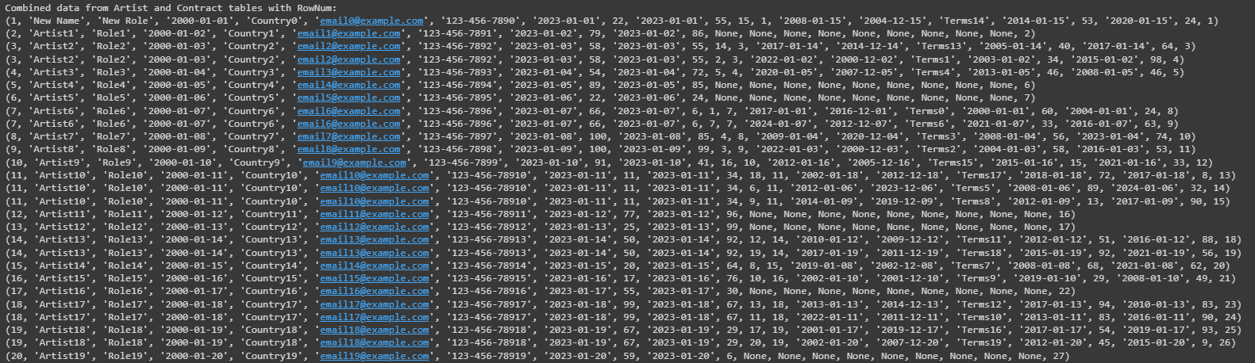
ADVANCED SQL - VU NGUYEN BAO NGOC - 12225193
6) Combine artist and contract data

Slide 38
QUERIES QUERIES QUERIES Q
QUERIES QUERIES QUERIES Q
QUERIES QUERIES QUERIES Q
QUERIES QUERIES QUERIES Q
CHAW THIRI SAN
12225272

Slide 39
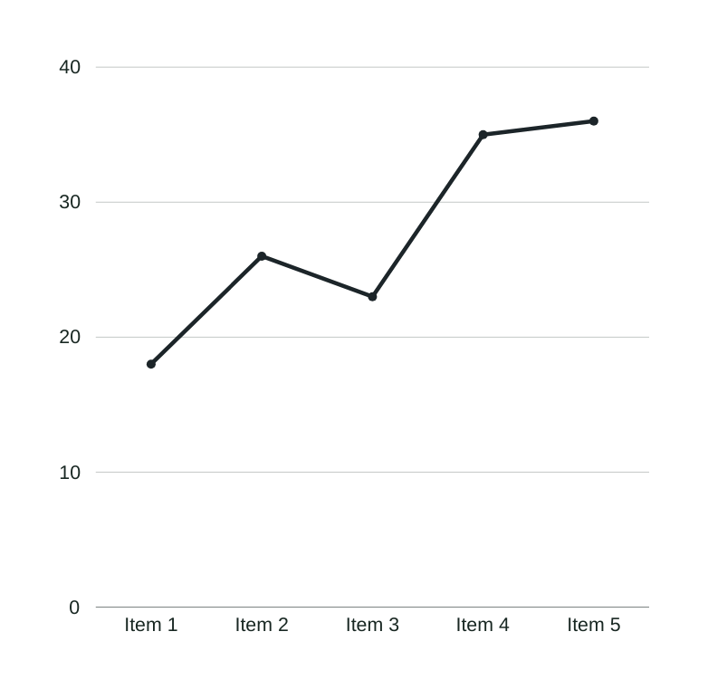
Database Handling
INTERMEDIATE QUERY
Total Revenue generated by each artist
The top 10 BEST SELLING ALBUMS
Artists having album with less than 3 songs

Slide 40
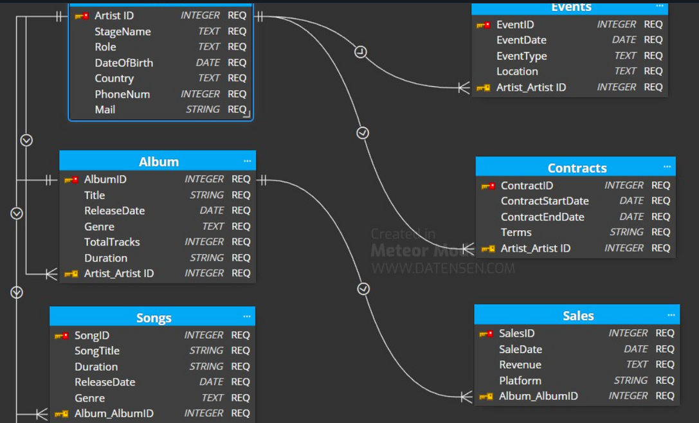
INTERMEDIATE SQL - CHAW THIRI SAN - 12225272
1) Total revenue generated by each artists
To get all the artists, left join on artist table
Since there is no direct connection between artist and sale, “album” table in between them is used.
To use aggregate function sum, group by is used to combine all the revenue of each artists

Slide 41
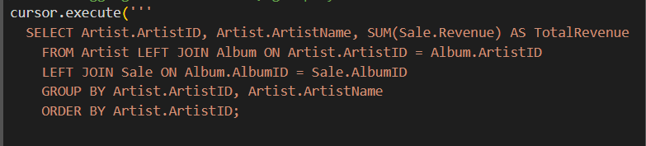
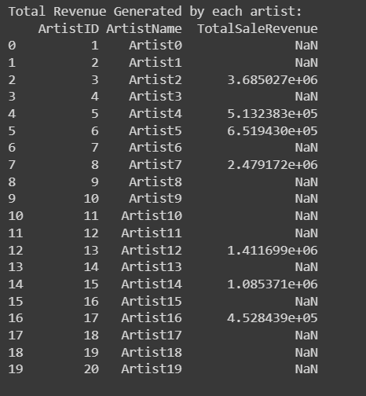
RESULT
Select ID and name from the Artist table
used Album table as a connecting table
Left join the Sale table, so that it will not lose any artists
Use aggregate function sum to add the total revenue group by artistID
P.s not every artist has albums or songs , so they have no total revenue

Slide 42
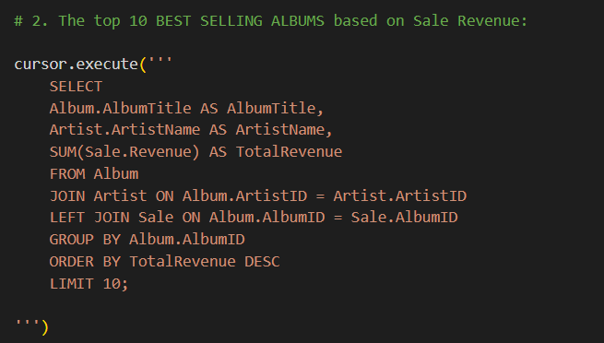
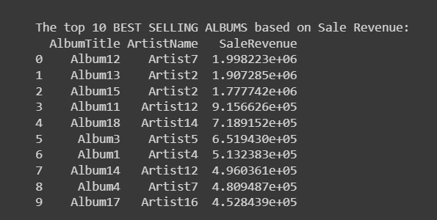
INTERMEDIATE SQL - CHAW THIRI SAN - 12225272
2) 10 BEST SELLER ALBUMS
New keywords
Group by; Order by; Limit; Complex join

Slide 43
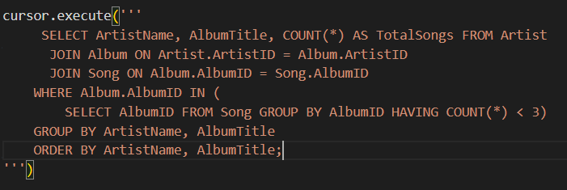
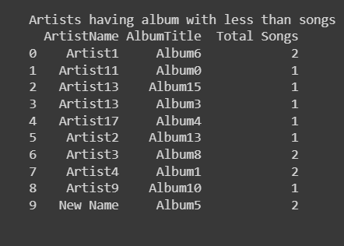
INTERMEDIATE SQL - CHAW THIRI SAN - 12225272
3) Artists having albums with less than 3 songs
Keywords
Count() to count the number of rows having the same album id

Slide 44

Advanced Query
Advanced Query
TOPICS
Advanced Query
Percentage Contribution of Albums in Artist’s Total Profits
Delete artists whose contract has expired before 2020
Ranking the artists based on their income
Advanced Query

Slide 45
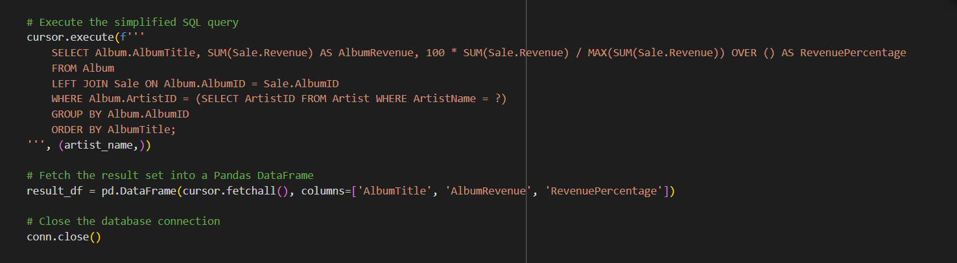
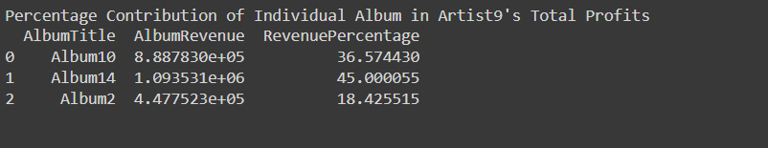
ADVANCED SQL - CHAW THIRI SAN - 12225272
4) Percentage Contribution of Albums in Artist’s Total Profits

Slide 46
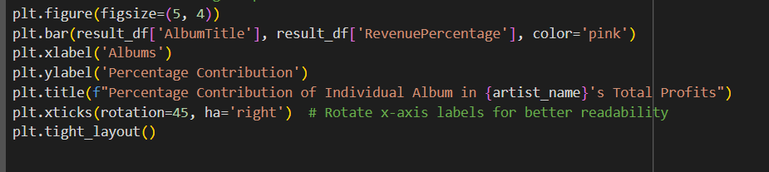
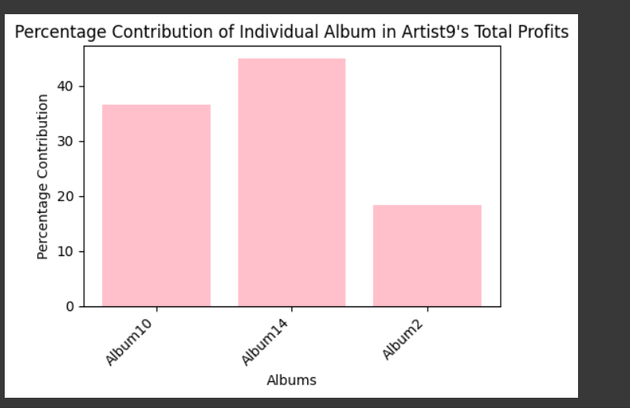
Make a bar chart using matplot to vistualize the data

Slide 47
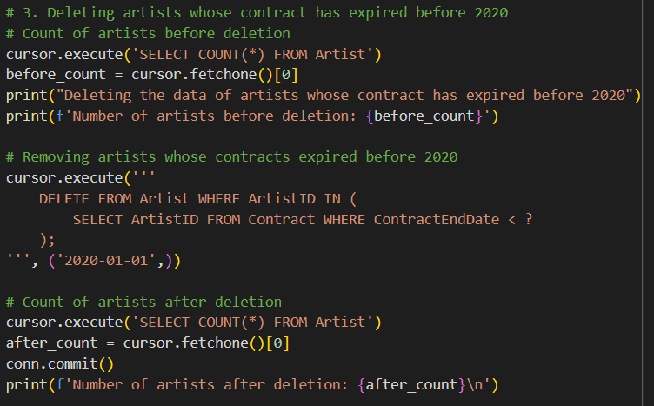
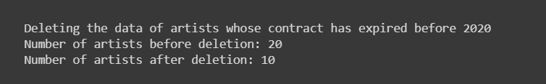
ADVANCED SQL - CHAW THIRI SAN - 12225272
5) Delete artists whose contract has expired before 2020
Feature
Delete keyword

Slide 48
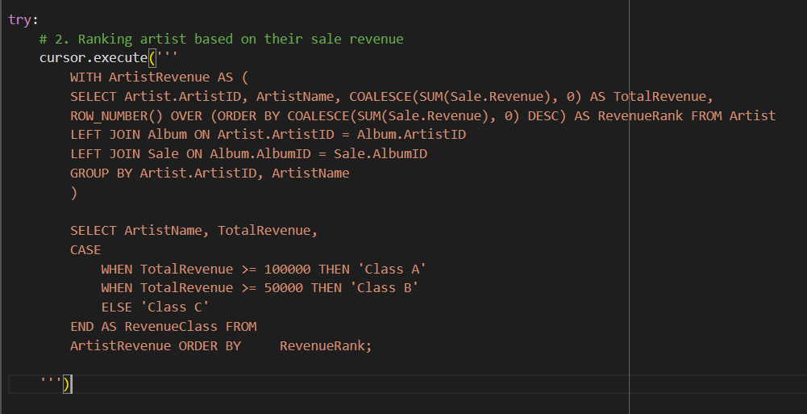
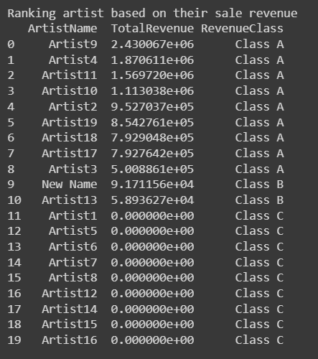
ADVANCED SQL - CHAW THIRI SAN - 12225272
6) Ranking the artists based on their income
Other features
CTE
Window function (row_number())
Coalesce() to handle null valuee
Use a rollback mechanism to cancel the operation once an error pops up

Slide 49
MUSIC LABEL MUSIC LABEL M
MUSIC LABEL MUSIC LABEL M
MUSIC LABEL MUSIC LABEL M
THANK YOU
MUSIC LABEL MUSIC LABEL M

